Slide 1
Announcement
Ben Ellis – office hours canceled tonight

Slide 2

Kurt Cobain
1967-1994

Slide 3
Webpage Layout and Website Design
Technical definitions:
  A webpage is a single HTML document
  A website is a collection of related webpages
Designing a good website requires more than just putting together a few pages

Slide 4
Examples
www.projectpuffin.org
www.pmlodge.com
www.uintafishing.com
www.uncommonadv.com

Slide 5
Web Page Layout
Layout of web pages is very important
Poor layout makes for -
  Difficult navigation
  Hard to locate information on page
  Visually unappealing

Slide 6
Tables, tables, tables!
Use tables to lay out your pages!
Make the table borders invisible
A 2x2 table works well

Slide 7
Areas of a Web Page
Logo
Header
Menu
Content

Slide 8
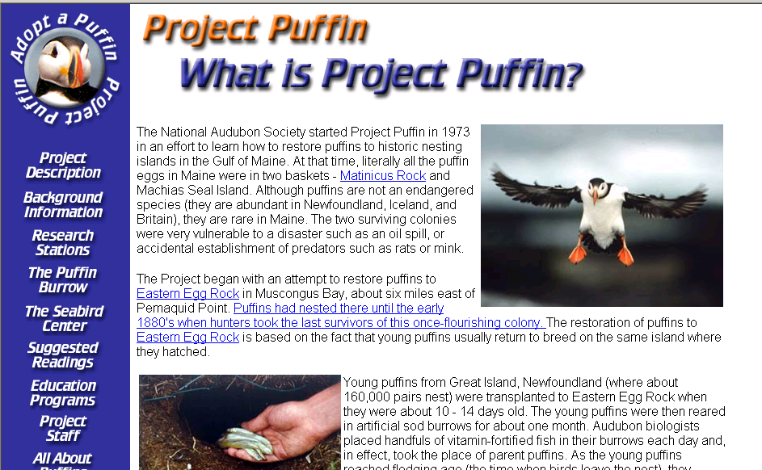
A 2 x 2 Layout

Slide 9
Other Designs
www.adobe.com (menu on right)
www.uintafishing.com (many columns)

Slide 10
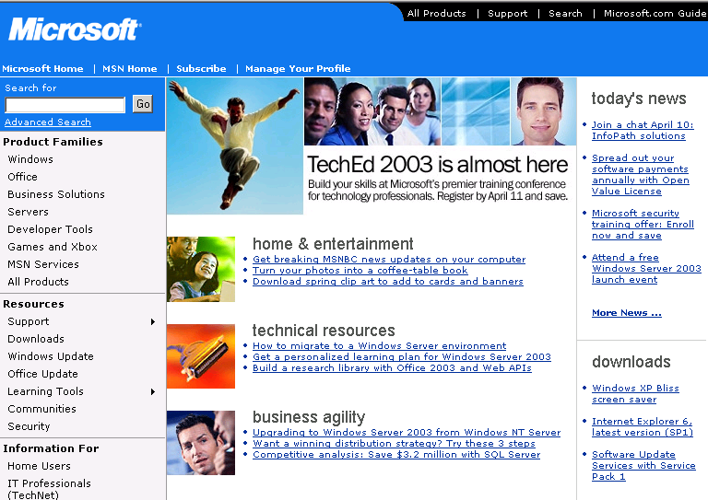
Table within a table

Slide 11
The outer table

Slide 12
The inner table

Slide 13
The inner table

Slide 14
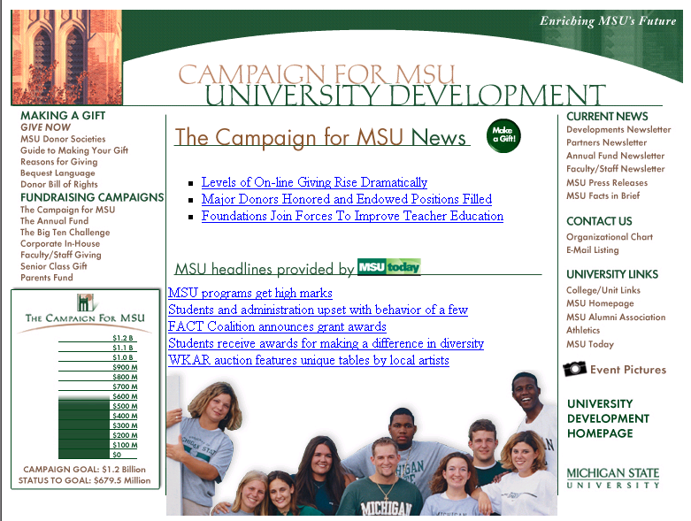
Centered with three columns

Slide 15
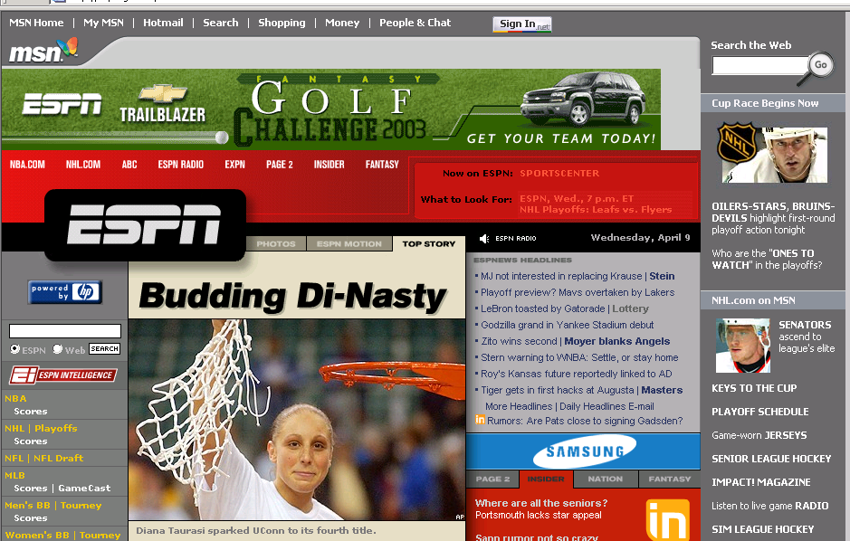
Really complicated design!

Slide 16
Monitors and Dimensions
Monitor resolution affects how you should lay pages out
800x600 = 50% - 760 x 420 pixels in browser window
1024x768 = 35%
640x480 = 3%* - 595 x 360 pixels
    *Was 20% three years ago

Slide 17
Dimensions in a 2x2 table
Up to 760 wide*
100-140
wide
Up to 650 wide
Logo
And
Menu
Header
Content

Slide 18
Different Resolutions
http://www.dreamink.com/design6.shtml

Slide 19
Page Width
Because monitors differ (640x480, 800x600, 1024x768), pages look different.
You can use a % width for a table, for example make it 80% of the page width

Slide 20
Splash Page
The index.html file is called the “Splash Page”
It is the key page—the first page visitors usually see
Must be visually attractive, informative, and easy to navigate
Examples:
    www.projectpuffin.org
    www.pmlodge.com
    www.uncommonadv.com
    www.rainforestandreef.org

Slide 21
Organizing Information
Decide what info goes on each page
  Friends page
  Family page
  Personal page
  Hobbies page

Slide 22
Good Web Communication
Be Concise
Limit choices – use a hierarchical structure
  A hierarchy is a structured organization where some pages are at a higher level than others
  Hierarchy results in a site map with multiple levels

Slide 23
Site Map
A site map is designed to show the connections between pages
A graphical site map uses lines to connect linked pages

Slide 24
Site Map
Willoughby's Website
Splash Page
index.html
Pictures Gallery
gallery.html
Name Page
name.html
Progress Page
progress.html
Interior or
Internal
Pages
Canada Trip
canada.html
Christmas Tree
tree.html

Slide 25
Design Theme
Choose a common layout for your website. The Splash Page will probably differ but interior pages should be the same
Use tables to control placement throughout

Slide 26
Consistency in Design
Use the same font throughout!
Use consistent graphics in website – do not use ultra modern on one page and calligraphy on another
Use color scheme that is consistent

Slide 27


The Font Barrier
Only fonts you can reliably use are Times New Roman (Times) and Arial (Helvetica)
Text in site should be one of these choices
How to overcome this?
  Any font used in graphics is loaded as a graphic, and does not rely upon the font being on the user’s computer
  Make cool font images in Photoshop

Slide 28
Testing
Test your website as you go along.
  If you’re in the computer lab and there’s an empty computer next to you, log into it and check out your web page from there
Make sure it works in Netscape Navigator and Internet Explorer
Make sure all pictures come up on a different machine

Slide 29
Assignment 8 – Website Design
From your existing web pages, build a website.
  Add more pages to site – whatever you want
    Some suggestions: Resume, friends page, hobbies page
    Minimum 6 pages (splash page + 5)
  Use common design theme
    Make custom graphics in PhotoShop
Prepare graphical site map in PowerPoint to turn in when finished

Slide 30
Where to get help on design
Web Pages for more info
  http://info.med.yale.edu/caim/manual/contents.html
Good places for Graphics
  www.clipart.com
  http://free-clip-art.com/
Fonts
  http://www.1001freefonts.com/fontfiles/main.htm

Slide 31
Assignment 7 – Advanced Webstuff
Add Hyperlinks
Add Graphics (MSU, Scans, etc)

